Slide 1
What do we need?
2 glasses, 1 with salt and water and another one with water
1 balloon with water and salt
A spoon
A funnel

Slide 2
Floating and sinking
S
STEP 1
Fill a glass with water and salt.
STEP 2
Put the mix in a balloon and make sure that there is no air inside.
STEP 3
- - - - - - - -
Cut the top of the balloon.
STEP 4
Fill a glass with water and the other glass with plenty of salt and water.
STEP 5
Put the balloon in each glass and observe what happens.

Slide 3
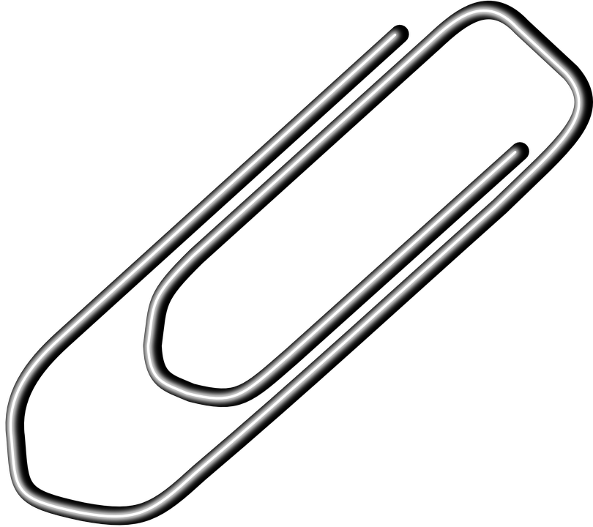
Lesson: To Float or Not to Float
What you need:
Paperclips
Water
EXPERIMENT 1
Paper clip in water: try putting some paper clips (vertical and horizontal) in the water
What Happens? Are there any differences?
EXPERIMENT 2
What you need:
Paper
Coins
Sail boats: place a boat in the water, does it float?
Add coins until it sinks. How many coins does it need to sink? Try to design a boat that holds more coins.
What you need:
Whiteboard marker
Plate
EXPERIMENT 3
Use a whiteboard marker to draw on a plate, immediately cover it with water and watch what happens.
FLOAT
Plate

